Slide 1

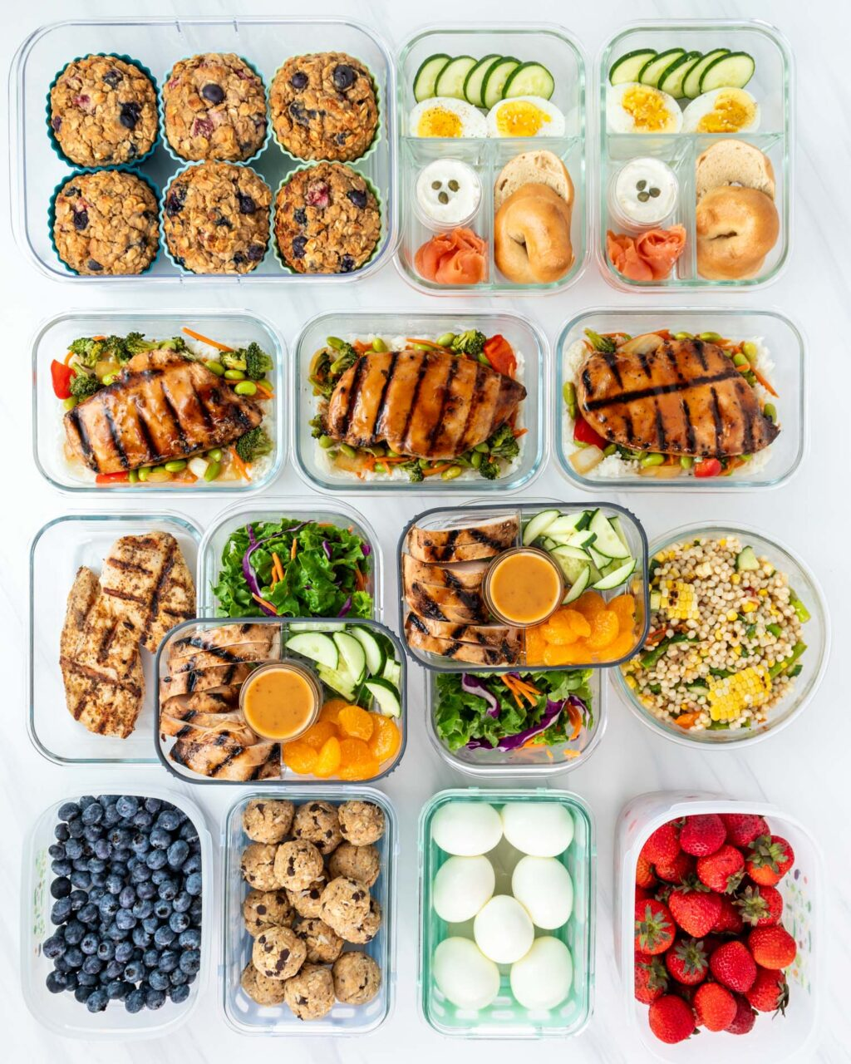
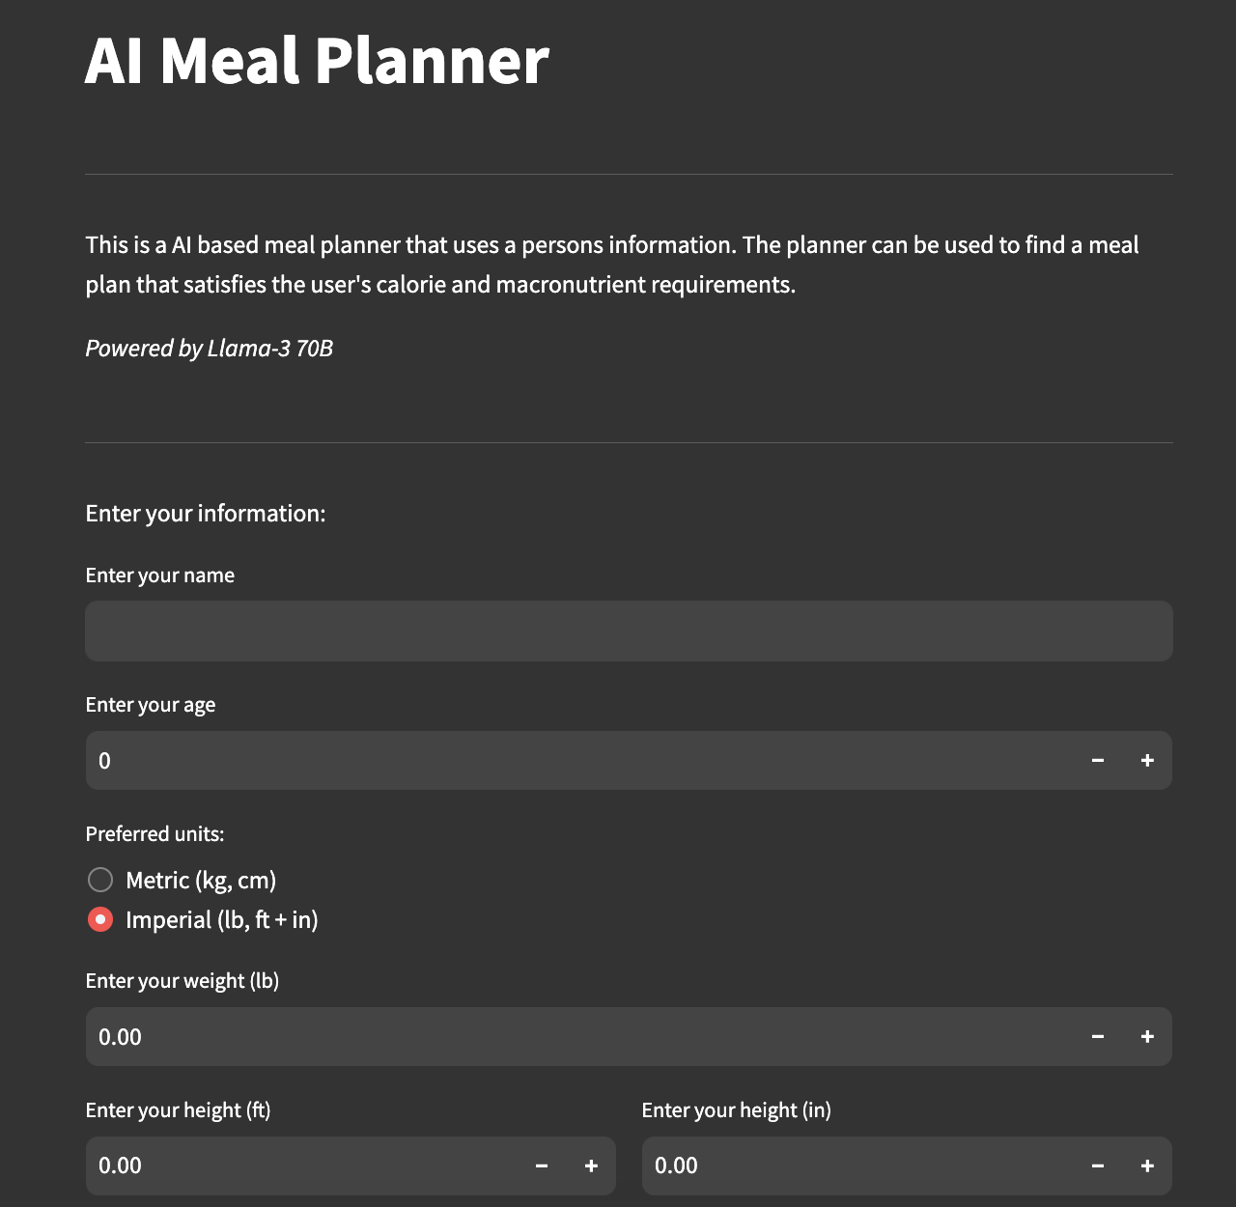
Meal Prep Manager
Coders: Brandon McKie, Jalyn Smith, Jack Taube, Ricnesha Priester
“Tired of the mayhem in the kitchen? Ease your mind and let us manage the meals for you!
https://github.com/ksu-hmi/meal-prep-manager

